Slide 1



Open Minds Club
AI School Iteration 1.7
Further Preprocessing & ML Pipeline
By BOULGHERAIF Fatma Zohra
<h4>
</h4>

Slide 2

Open Minds Club
01.Data Viz Review

Slide 3
Open Minds Club
01. Iteration 1.6 Review: Data Viz
👉 https://www.datacamp.com/tutorial/seaborn-python-tutorial

Slide 4
Open Minds Club
02. Feature Scaling

Slide 5
Open Minds Club
02. Feature Scaling: Why?
Problem: ML algorithms that use distances or gradients are sensitive to the magnitude of features.
Example:
  age: 25, 30, 45
  salary: 30,000 · 80,000 · 120,000
→ Salary dominates the model. Not because it matters more, but because it's bigger.
NB:
Affected: KNN · SVM · Linear/Logistic Regression · Neural Networks · PCA
Not affected: Decision Trees · Random Forests (split-based, not distance-based)

Slide 6
Open Minds Club
02. Scaling: Absolute Maximum / Divide by Max
Formula: X' = X / X_max
Result: Values scaled to range [0, 1], but only if data has no negatives.
Example:
Limitation: Sensitive to outliers.
When to use: Quick normalization when you know the data is positive and clean.
60 | 120 | Original | 30
0.5 | 1 | Scaled | 0.25

Slide 7
Open Minds Club
02. Scaling: Min-Max Scaling
Formula: X' = (X − X_min) / (X_max − X_min)
Result: Values always in range [0, 1]
Example:
Limitation: Sensitive to outliers.
When to use: When you know the bounds of a feature
60 | 120 | Original | 30
0.33 | 1 | Scaled | 0

Slide 8
Open Minds Club
02. Scaling: Standard Scaling / Z-score Normalization
Formula: X' = (X − μ) / σ
Result: Mean = 0, Std Dev = 1. No fixed range.
Example:
Works well when data is roughly Gaussian. Robust for most ML algorithms
55 | 100 | Original | 10
0 | 1.22 | Scaled | -1.22

Slide 9
Open Minds Club
02. Scaling: Robust Scaler
Formula: (X − median) / IQR, aka (X - Q2) / (Q3 - Q1)
Result: Centered on median, scaled by interquartile range. Outliers have minimal effect.
Example:
It maintains the structure of data
55 | 500 | Original | 10
+0.23 | 3.81 | Standard Scaler | −0.57
0.00 | +7.22 | Robust Scaler | −0.67

Slide 10
Open Minds Club
03. Encoding Categorical Features

Slide 11
Open Minds Club
03. Encoding Categorical Variables: Why?
Machine learning algorithms work with numbers, they cannot process raw text labels.
📌 Rule of thumb
  2 categories → Binary Encoding
  Many categories, no order → One-Hot Encoding
  Ordered categories → Ordinal Encoding

Slide 12
Open Minds Club
03. Binary Encoding
When to use: Binary categorical variable (only 2 possible values)
Example: Gender
  Male: 0
  Female: 1
df['gender'] = (df['gender'] == 'Female').astype(int)

Slide 13
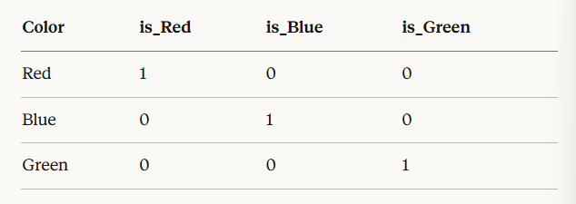
Open Minds Club
03. One-Hot Encoding OHE
When to use: Nominal categories with no natural order (e.g. color, city, product type)
Example: Color
  Red: [1, 0, 0]
  Green: [0, 1, 0]
  Blue: [0, 0, 1]
  Red: [0, 0] . Green: [1, 0] . Blue: [0, 1]
pd.get_dummies(df, columns=['color'], drop_first=True)

Slide 14
Open Minds Club
03. Ordinal Encoding
When to use: Ordinal categories (where order matters)
Example: Salary
  Low: 0
  Medium: 1
  High: 2
Use sklearn.preprocessing.OrdinalEncoder, or simply, pandas df.replace method

Slide 15
Open Minds Club
04. Missing Values

Slide 16
Open Minds Club
04. Missing Values
  Remove rows: # of missing values < 5%
  Drop column: # of missing values > 50%
  Impute by mean/median: Use median when outliers are present; mean for clean distributions.
  Impute by mode: for categories

Slide 17
Open Minds Club
05. Outliers

Slide 18
Open Minds Club
05. Outliers (Reminder)
Definition: Data points that sit far from the rest of the distribution.
Detection methods:
  IQR method: Outlier if X < Q1 − 1.5×IQR or X > Q3 + 1.5×IQR
  Z-score: Outlier if |z| > 3

Slide 19
Open Minds Club
05. Outliers (Reminder)
How to handle:
Option | When
Remove / Impute | Clearly erroneous values
Keep | Algorithm is tree-based (not sensitive)
Use Robust Scaler | Keep the value, reduce its influence

Slide 20
Open Minds Club
06. Feature Engineering

Slide 21
Open Minds Club
06. Hand-crafted Features
Creating new features from existing ones using domain knowledge.
Examples:
  bmi | weight / height² | Clinically meaningful
  age_group | bin age into ranges | Captures non-linear patterns
  is_weekend | extract from date | Behavior changes weekends
  revenue_per_user | revenue / users | Normalizes for scale
=> A model can only learn from what you give it. A smart feature can matter more than a sophisticated algorithm.

Slide 22
Open Minds Club
07. ML Pipeline

Slide 23
Open Minds Club
07. The ML Pipeline
Data
Clean
Engineer
Split
Scale
Train
Evaluate

Slide 24
Open Minds Club
08. Train/Test Split

Slide 25
Open Minds Club
Split
Scale
08. Train/Test Split
The idea: Before training, split your dataset into two parts: one to learn from, one to evaluate on.
=> (Studying past exams)
Split | Purpose | Typical Size
Training set | Model learns patterns from this | 70-80%
Test set | Simulates unseen data | 20-30%

Slide 26
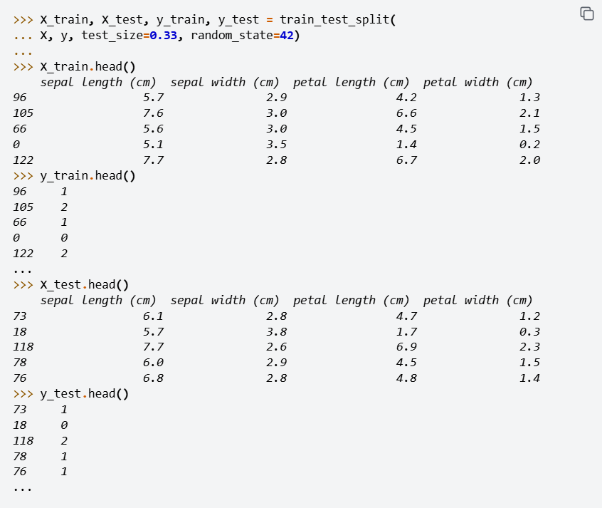
Open Minds Club
Split
Scale
08. Train/Test Split
sklearn.model_selection.train_test_split

Slide 27
Open Minds Club
Split
Scale
08. The three-way split
Train, Validation & Test Split
Split | Purpose | Typical Size (%)
Training set | Model learns patterns from this | 60-70
Validation set | Tune hyperparameters, compare models | 15-20
Test set | Final evaluation only (touch once) | 15-20

Slide 28
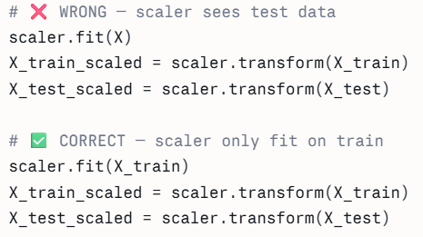
Open Minds Club
08. Train/Test Split & Leakage
Data leakage: When information from the test set "leaks" into training, making your model look better than it really is.
Split
Scale

Slide 29

Open Minds Club
Any Questions ?

Slide 30
Open Minds Club
Thank you for your attention ✨

